Slide 1
Generic Session 10
Course : COMP 6175
Object Oriented Programming
Effective Period : October 2018

Slide 2
Outline
- Introduction - Generic Classes and Interfaces - Generic Methods

Slide 3
What is generic?
Generics enable to detect errors at compile time rather than at runtime. A generic class or method permits you to specify allowable types of objects that the class or method can work with. If you attempt to use an incompatible object, the compiler will detect that error.
For example, the following statement creates a list for strings:
ArrayList<String> list = new ArrayList<>();

Slide 4
Generic
You can now add only strings into the list. For instance,
list.add("Red");
If you attempt to add a nonstring, a compile error will occur. For example, the following statement is now illegal, because list can contain only strings.
list.add(new Integer(1));

Slide 5
Advantages of Generics
Code Reuse: We can write a method/class/interface once and use for any type we want.
Type Safety : Generics make errors to appear compile time than at run time (It’s always better to know problems in your code at compile time rather than making your code fail at run time). For example, you want to create an ArrayList that store name of students and if by mistake programmer adds an integer object instead of string, compiler allows it. But, when we retrieve this data from ArrayList, it causes problems at runtime.

Slide 6
Advantages of Generics
Individual Type Casting is not needed: If we do not use generics, then, in the above example every-time we retrieve data from ArrayList, we have to typecast it. Typecasting at every retrieval operation is a big headache. If we already know that our list only holds string data then we need not to typecast it every time.
Implementing generic algorithms: By using generics, we can implement algorithms that work on different types of objects and at the same they are type safe too.

Slide 7
Generic Classes and Interfaces
A generic type can be defined for a class or interface. A concrete type must be specified when using the class to create an object or using the class or interface to declare a reference variable.

Slide 8
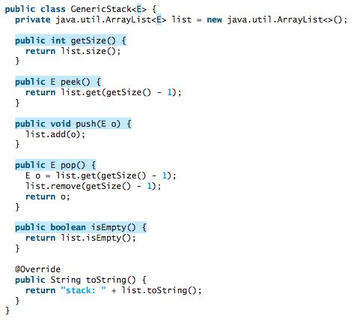
Generic Classes and Interfaces

Slide 9
Generic Classes and Interfaces
The following example creates a stack to hold strings and adds three strings to the stack:
GenericStack<String> stack1 = new GenericStack<>(); stack1.push("London"); stack1.push("Paris"); stack1.push("Berlin");

Slide 10
Generic Classes and Interfaces
This example creates a stack to hold integers and adds three integers to the stack:
GenericStack<Integer> stack2 = new GenericStack<>(); stack2.push(1); // autoboxing 1 to new Integer(1)
stack2.push(2); stack2.push(3);

Slide 11
Generic Classes and Interfaces
Instead of using a generic type, you could simply make the type element Object, which can accommodate any object type.
However, using generic types can improve software reliability and readability, because certain errors can be detected at compile time rather than at runtime. For example, because stack1 is declared GenericStack<String>, only strings can be added to the stack. It would be a compile error if you attempted to add an integer to stack1.

Slide 12
Generic Methods
Generic methods are methods that introduce their own type parameters. This is similar to declaring a generic type, but the type parameter's scope is limited to the method where it is declared. Static and non-static generic methods are allowed, as well as generic class constructors.

Slide 13
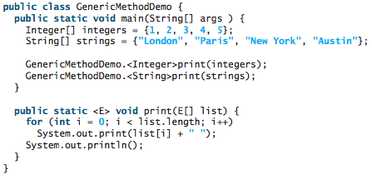
Generic Methods
To declare a generic method, you place the generic type <E> immediately after the keyword static in the method header.

Slide 14
Generic Methods
For example,
public static <E> void print(E[] list)
To invoke a generic method, prefix the method name with the actual type in angle brackets.
For example,
GenericMethodDemo.<Integer>print(integers); GenericMethodDemo.<String>print(strings);
or simply invoke it as follows:
print(integers);
print(strings);

Slide 15
References
Daniel Liang, Y., 2015, Introduction to java programming, vol.10, Pearson Education, New Jersey.
Generic:
https://docs.oracle.com/javase/tutorial/java/generics/why.html
https://www.geeksforgeeks.org/generics-in-java/
https://docs.oracle.com/javase/tutorial/java/generics/methods.html

